Slide 1


AWS GEN AI

Slide 2
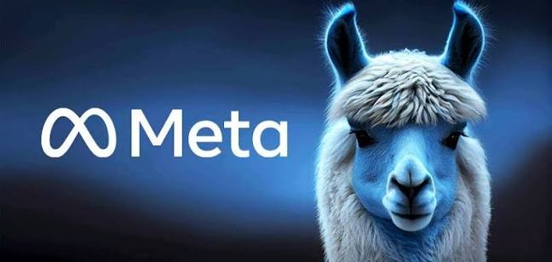
LLAMA (META) – OPEN-WEIGHT FLEXIBILITY & CUSTOMIZATION

Slide 3

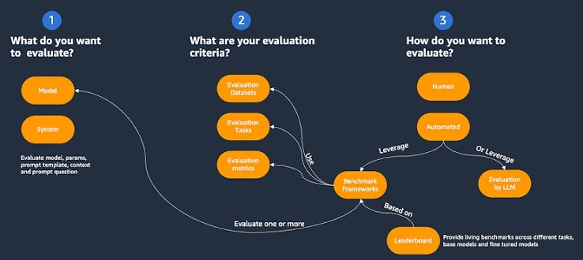
MODEL SELECTION FRAMEWORK

Slide 4
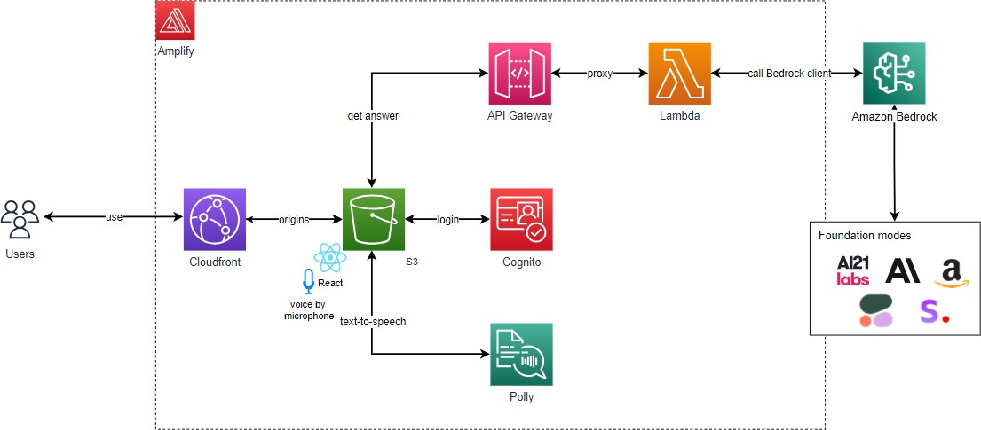
BEDROCK PLAYGROUNDS

Slide 5
THANKS FOR WATCHING

